Slide 1


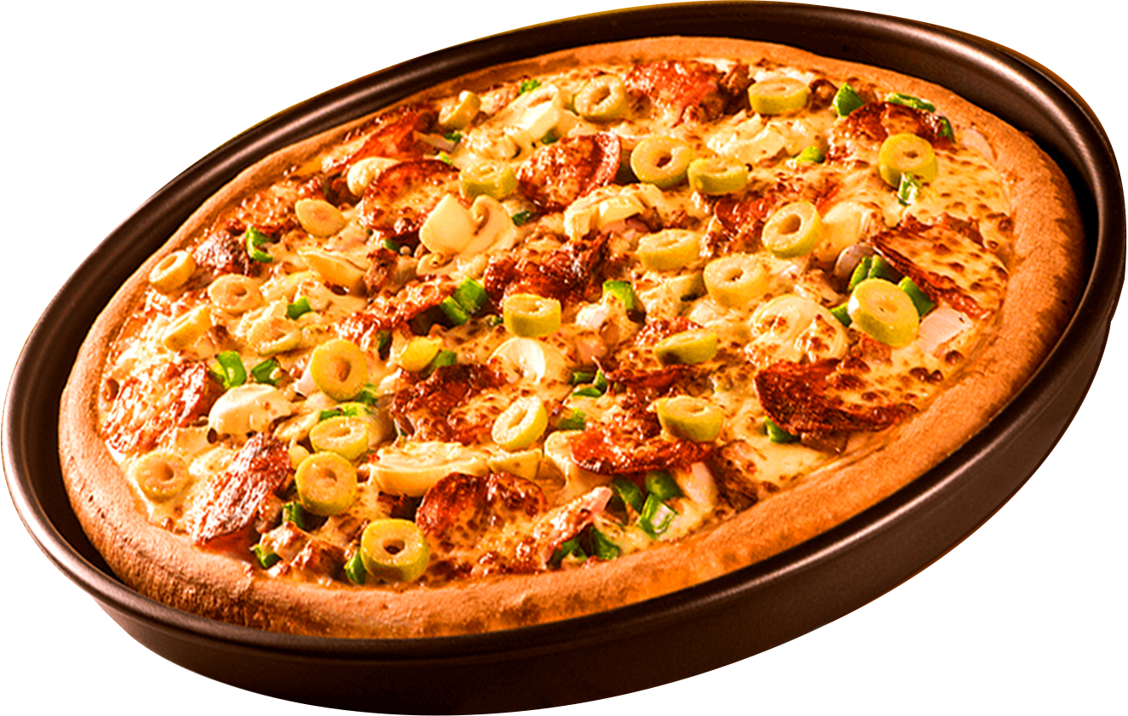
PIZZA SALES ANALYSIS

Slide 2
ABOUT THIS PROJECT
Our Passion for Pizza
My Pizza Sales Analysis Project focuses on solving business problems by analyzing sales data using SQL.
I wrote a series of SQL queries, ranging from basic to advanced, to extract actionable insights from the dataset.
Key areas of analysis included identifying best-selling pizzas, understanding peak sales hours, and uncovering customer preferences.
The project provided data-driven solutions for optimizing inventory management and pricing strategies.
SQL queries were designed to highlight performance metrics, such as sales trends and underperforming menu items.
This project demonstrates the power of SQL in addressing real-world business challenges effectively.

Slide 3

SQL QUERY
THE TOTAL NUMBER OF ORDERS PLACED.

Slide 4
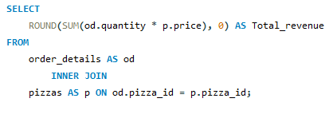

SQL QUERY
THE TOTAL REVENUE GENERATED FROM PIZZA SALES.

Slide 5
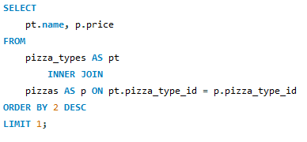

SQL QUERY
THE HIGHEST-PRICED PIZZA.

Slide 6
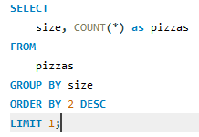

SQL QUERY
THE MOST COMMON PIZZA SIZE ORDERED.

Slide 7
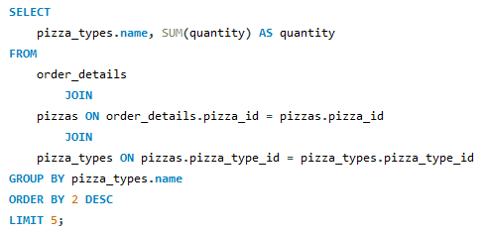
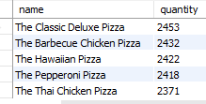
SQL QUERY
TOP 5 MOST ORDERED PIZZA TYPES ALONG WITH THEIR QUANTITIES.

Slide 8
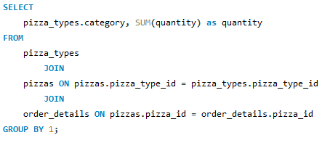

SQL QUERY
TOTAL QUANTITY OF EACH PIZZA CATEGORY ORDERED.

Slide 9
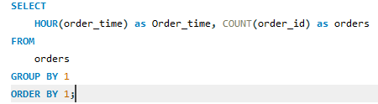
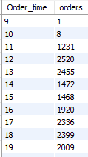
SQL QUERY
DISTRIBUTION OF ORDERS BY HOUR OF THE DAY

Slide 10
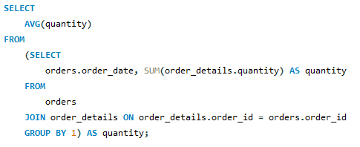

SQL QUERY
AVERAGE NUMBER OF PIZZAS ORDERED PER DAY

Slide 11
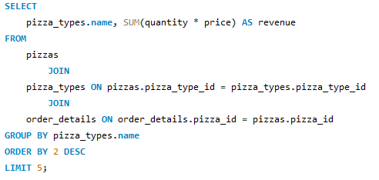

SQL QUERY
TOP 3 MOST ORDERED PIZZA TYPES BASED ON REVENUE

Slide 12
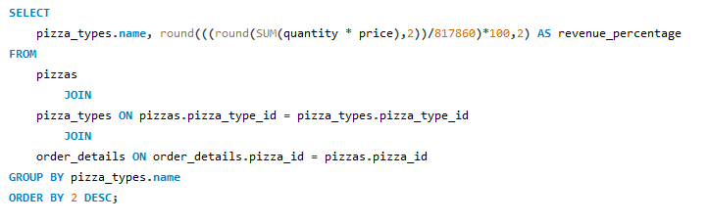
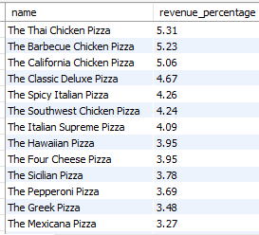
SQL QUERY
PERCENTAGE CONTRIBUTION OF EACH PIZZA TYPE TO TOTAL REVENUE

Slide 13
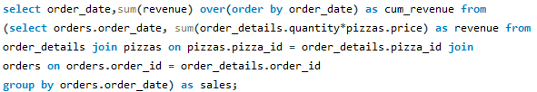
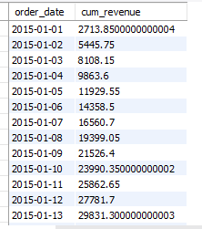
SQL QUERY
THE CUMULATIVE REVENUE GENERATED OVER TIME

Slide 14
THANK YOU
FOR ATTENTION

